Slide 1







PIZZA SALES SQL PROJECT

Slide 2


PROJECT OVERVIEW
Name: Yeshwanth K.
Objective: Analyze pizza sales data using SQL to extract key insights.
Scope:
Basic Analysis: Total orders, revenue, top pizzas, etc.
Intermediate Analysis: Pizza categories, order distribution, etc.
Advanced Analysis: Revenue contribution, cumulative revenue, etc.
Tools Used: SQL, Database Management

Slide 3
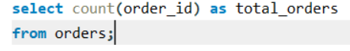
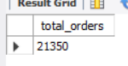
Retrieve the total number of orders placed.
Solution
Output
Basic

Slide 4
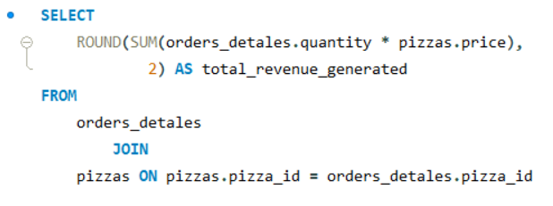
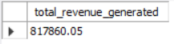
Calculate the total revenue generated from
pizza sales.
Solution
Output
Basic

Slide 5
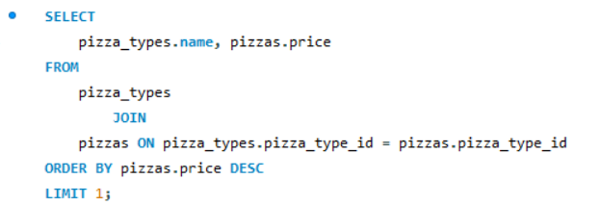
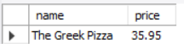
Identify the highest-priced pizza.
Solution
Output
Basic

Slide 6
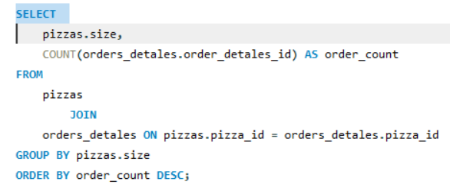
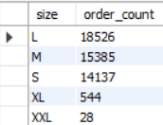
Identify the most common pizza size ordered.
Solution
Output
Basic

Slide 7
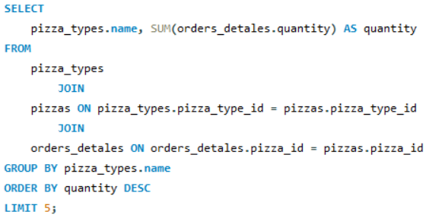
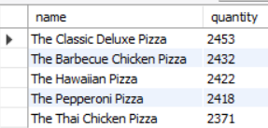
List the top 5 most ordered pizza types along
with their quantities.
Solution
Output
Basic

Slide 8
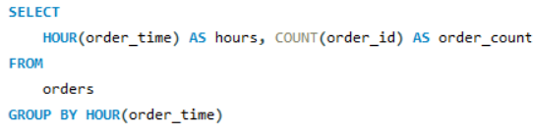
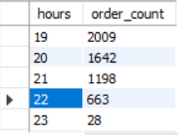
Determine the distribution of orders by hour
of the day.
Solution
Output
Intermediate

Slide 9
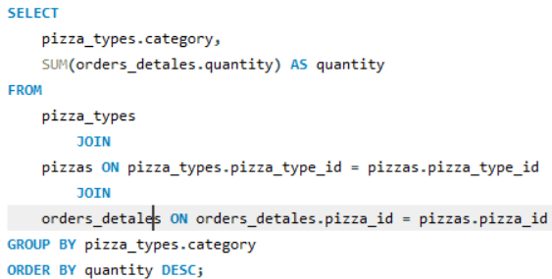
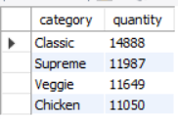
Join the necessary tables to find the total quantity of each pizza category ordered.
Solution
Output
Intermediate

Slide 10
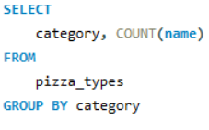
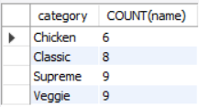
Join relevant tables to find the category-wise distribution of pizzas.
Solution
Output
Intermediate

Slide 11
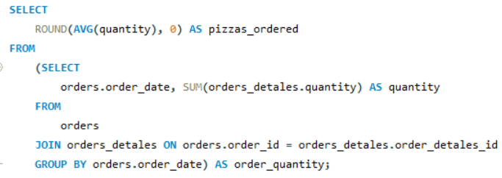
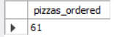
Group the orders by date and calculate the average number of pizzas ordered per day.
Solution
Output
Intermediate

Slide 12
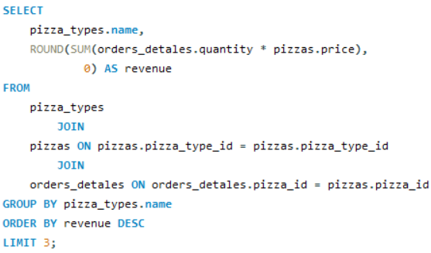
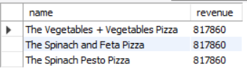
Determine the top 3 most ordered pizza
types based on revenue.
Solution
Output
Intermediate

Slide 13
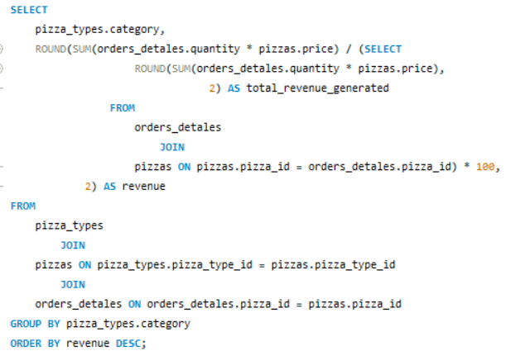
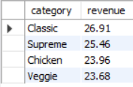
Calculate the percentage contribution of
each pizza type to total revenue.
Solution
Output
Advanced

Slide 14
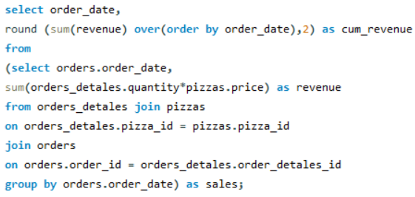
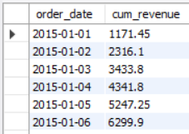
Analyze the cumulative revenue
generated over time.
Solution
Output
Advanced

Slide 15
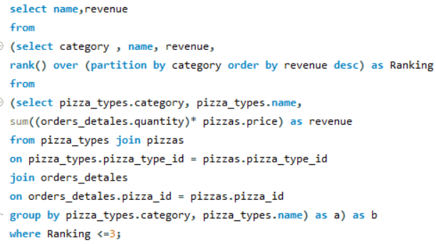
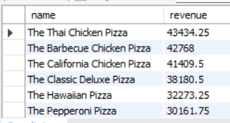
Determine the top 3 most ordered pizza types
based on revenue for each pizza category.
Solution
Output
Advanced

Slide 16
THANK YOU VERY MUCH!

